Slide 1
Zigbee-based Sensor Network
ENGR 391: Networking and Security

Slide 2
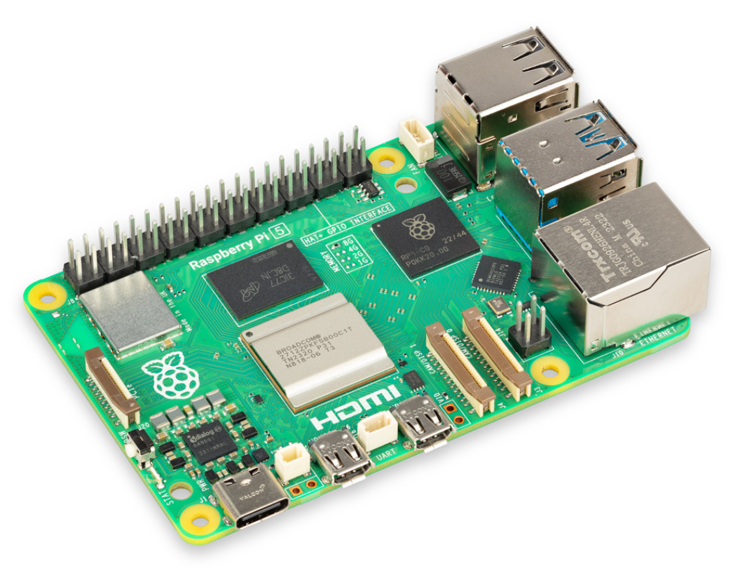
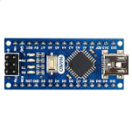
Project Overview
A wireless sensor network consisting of
Base station (Raspberry Pi)
Zigbee Radio
Sensor data collector
Data display
HTTP server (?)
Sensor node (Arduino)
Zigbee Radio
Sensor of some kind

Slide 3
Project Overview
Highlights
Use a Pi for the basestation and a microcontroller for the sensor.
Sensor is dumb and cheap
Base station is complex and more expensive, but
more features
allows for concurrency (multiple processes) easily
Use a high level language to enable more rich functionality
web server
graphical data dashboards ?

Slide 4
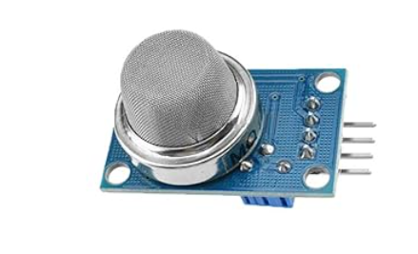
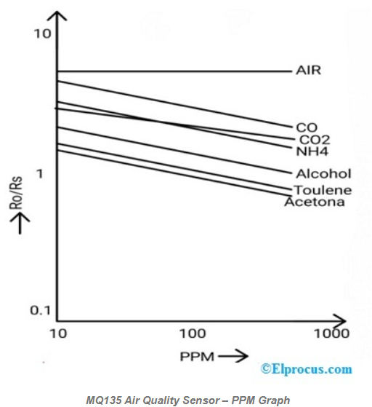
Sensor Module
Ximimark MQ135 Air Quality Sensor
Detects gases present in air like ammonia, benzene, smoke, carbon dioxide, etc.
Analog reading between 0V - 5V
Can also be used as a digital threshold
Has a set resistance in clean air and volatiles decrease this resistance causing a voltage increase
Output threshold can be set to determine a safe environment
Graph in the bottom right can be used to determine PPM value of volatiles
Where Ro is the resistance of the sensor in clean air
And Rs is the sensor resistance at gas concentration
MQ135 Air Quality Sensor Datasheet : Working & Its Applications (elprocus.com)

Slide 5
What is Zigbee
Uses IEEE 802.15.4 standard for Wireless PANs
Suitable for low-power and low data rate applications
smart home devices
sensors
other

Slide 6
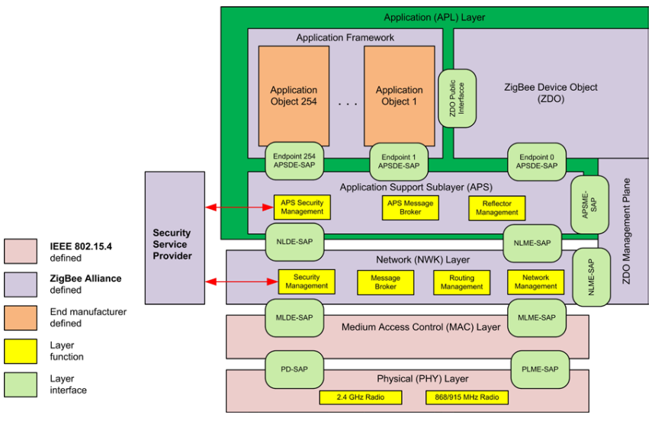
Zigbee Protocol stack
Whos responsible for what?

Slide 7
Zigbee Network Basics
Every Zigbee network can have 3 types of devices
Coordinator
One or more Routers
One or more Zigbee End Devices (ZEDs)
ZED
Router
Coordinator
ZED
Router
Router
ZED

Slide 8
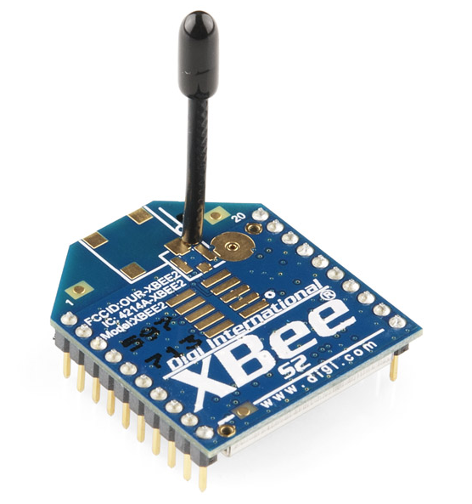
Zigbee in our project
The “network adapter” required to access our network
Digi Xbee module connected via UART

Slide 9
Configuration of Xbee modules
Two operating modes are available
AT (Application Transparent) mode
API mode

Slide 10
Configuration of Xbee modules
AT mode
Simple to use
Looks like serial communication for both the sender and receiver
Can be used on a dumb device like an arduino uno
API mode
More complex
Gives more control
packets can be crafted
addresses can be set
Device configuration

Slide 11
Base station system topology
Consists of 2 modules running concurrently:
Displayer.py
Data_collector.py
open(“sensor_data.csv”)
ttys0
Xbee
RX
TX
Base station (Pi)

Slide 12
Data Collector (Gory detail)
data_collector.py
Open serial port
ser = serial.Serial(“/dev/ttyUSB0”, 9600, timeout=1)
Read data (line by line)
line = ser.readline().decode('utf-8').rstrip()
Save the data
split up line into ID,VALUE pieces
keep the VALUE piece
append ISO8601 timestamp
Write to file
2023-11-17T21:31:51.089225,282
2023-11-17T21:31:52.090266,281
2023-11-17T21:31:53.091818,279
2023-11-17T21:31:54.091791,278

Slide 13
Display App
displayer.py
open data file
f = open(“sensor_data.csv”, 'rb')
read last 25 lines
last_n_lines = utils.read_last_n_lines(f, 25)
break up each line
curline = last_n_lines[0]
ID,value = curline.split(',')
Save the values in an array
Plot the values

Slide 14
Sensor topology
1 program: Data acquisition and transmission.
DAQ + Transmit
Xbee
Sensor (Arduino)
TX
RX

Slide 15
Design Considerations
Data format
In what format do the sensors send data to the base station?
Is that format scalable?
Concurrency
On base station, multiple processes are accessing the same file
What is the update rate of the data collector and data displayer?

Slide 16
Data Format Example
Naive approach
69
67
68
69
68
59
10
65
64
62
58
Using a sensor identity
(identity,value) tuples
HUMIDITY_ROOM600,62
PRESSR1,106
PRESSR1,105
TEMP_PUMP13,68
TEMP_PUMP13,59
HUMIDITY_ROOM600,62
TEMP_PUMP13,65
TEMP_PUMP13,64
HUMIDITY_ROOM600,62
HUMIDITY_ROOM205,58

Slide 17
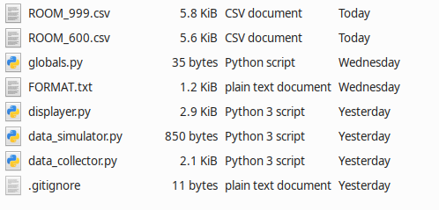
Data Format
With the IDENTITY,VALUE format, we can save data from multiple sensors
One CSV file for each sensor

Slide 18
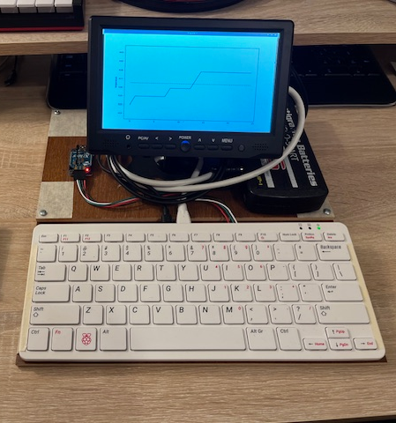
End results – Basestation
Base station
Collects data from sensor
Data is saved to separate CSV files
Can distinguish between good and bad data
Displays data in a window

Slide 19
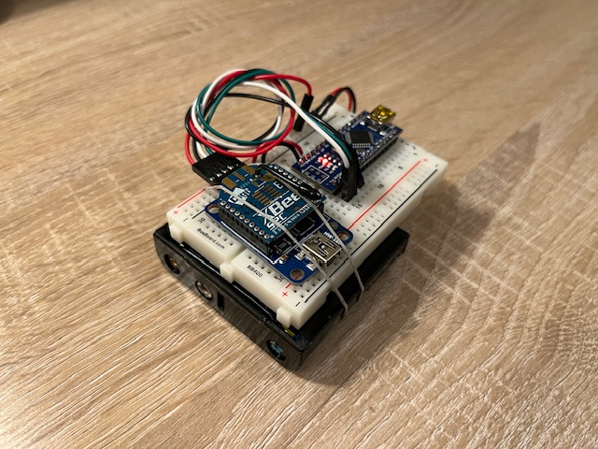
End results – Sensor node
Sensor node
Acquires data from sensor
Transmits the data

Slide 20
What next?
CSV files: how big do we allow them to get? Create a system that enumerates the CSV file names and creates new ones as needed. For example: sensor1.csv, sensor1-1.csv, sensor1-2.csv
Better Graphical display: Matplotlib is great for 1 graph in one window, but what if we want to display multiple data streams?
HTTP server: Create the web server that displays all data on some kind of dashboard. To start out, the web server could be accessed by the base station’s IP address assuming you were on the same network.

Slide 21
What next?
Do away with CSV files entirely? Use some kind of database perhaps?
Combine the data displayer and collector into one program – more efficient?

Slide 22
Demonstration
https://youtu.be/KIDjxMGVKeA

Slide 23
BEGIN
Internal notes

Slide 24
Tools used
Python: Programming language of choice
matplotlib - graphs
pyserial - serial communication with the Xbee
XCTU: software for setting up Xbee modules
set PAN id for each device
set destination address
set coordinator (CE) flag

Slide 25
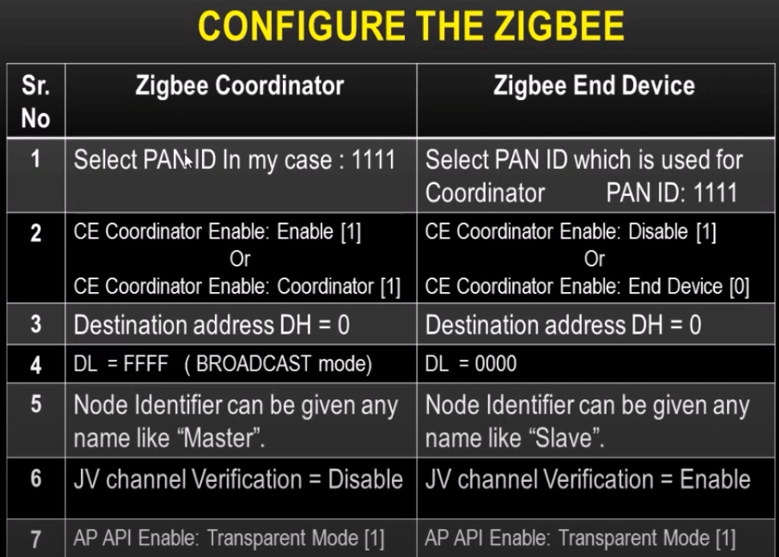
How to configure the Xbee module
To add a sensor to the network, you must first configure the Xbee modules with the XCTU software.
Each device on the network must share the same PAN ID. This number can be anything.
Coordinator has CE bit enabled

Slide 26
AT mode and API mode
In summary, transparent mode is simpler to use but lacks the advanced features of API mode. API mode is more complex but provides more control over the network and offers advanced features
Click here for more: Comparison of transparent and API modes (digi.com)

